Slide 1


Slide 2


Slide 3


Slide 4


Slide 5


Slide 6
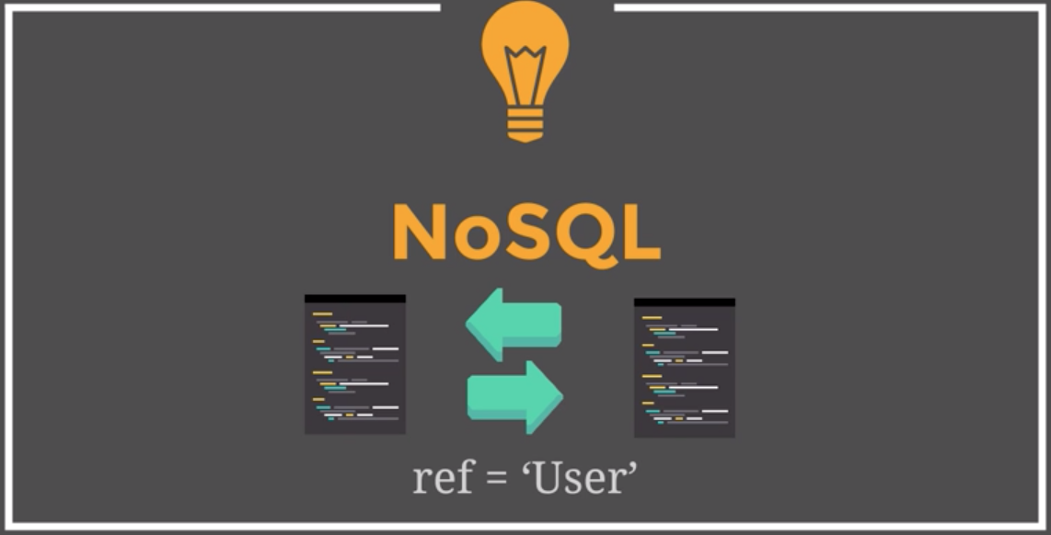

Slide 7


Slide 8
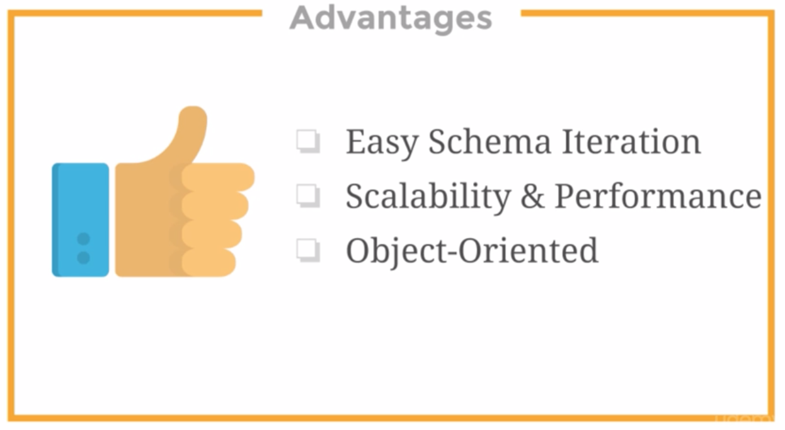

Slide 9
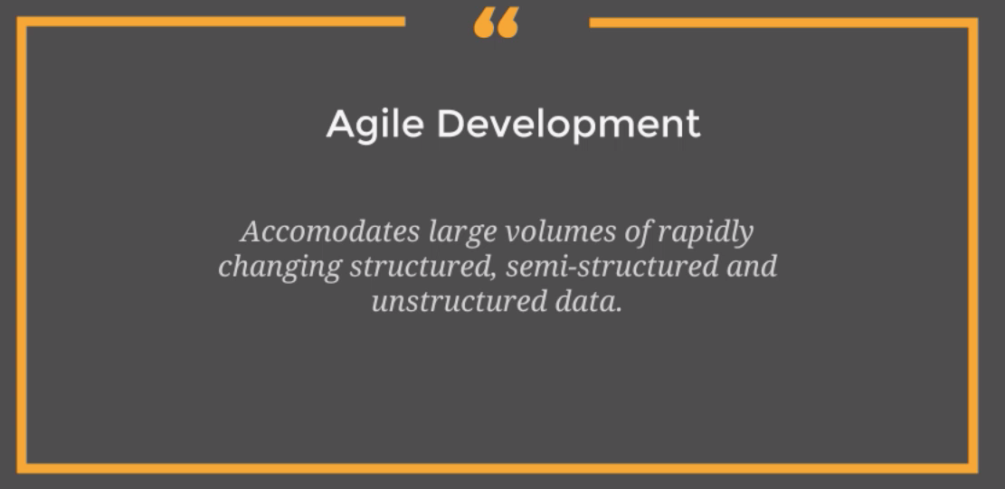

Slide 10
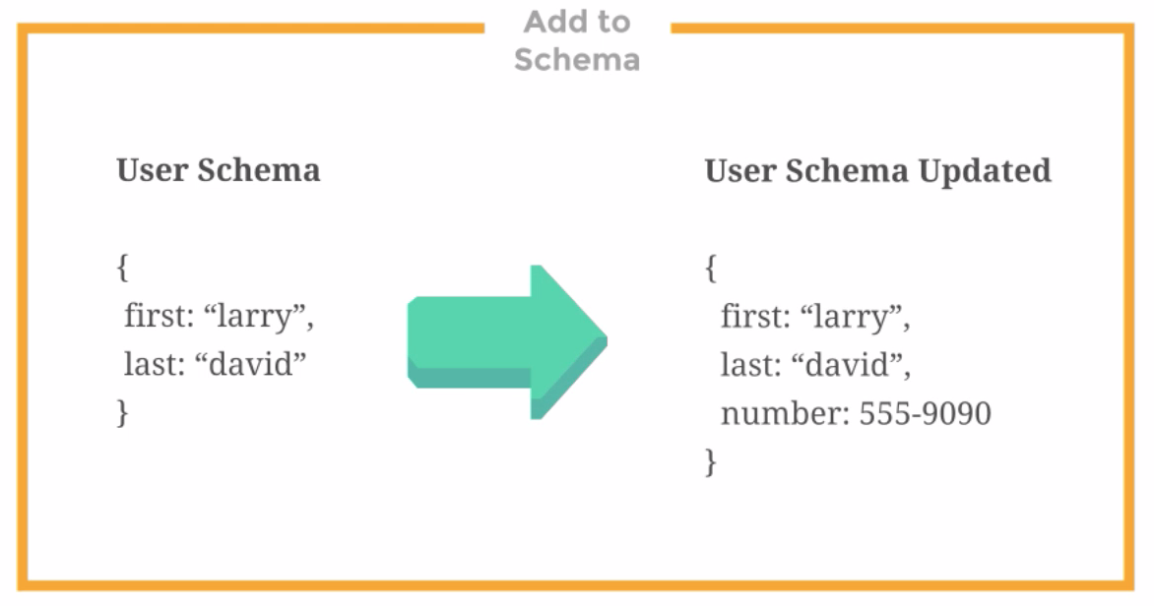

Slide 11


Slide 12


Slide 13
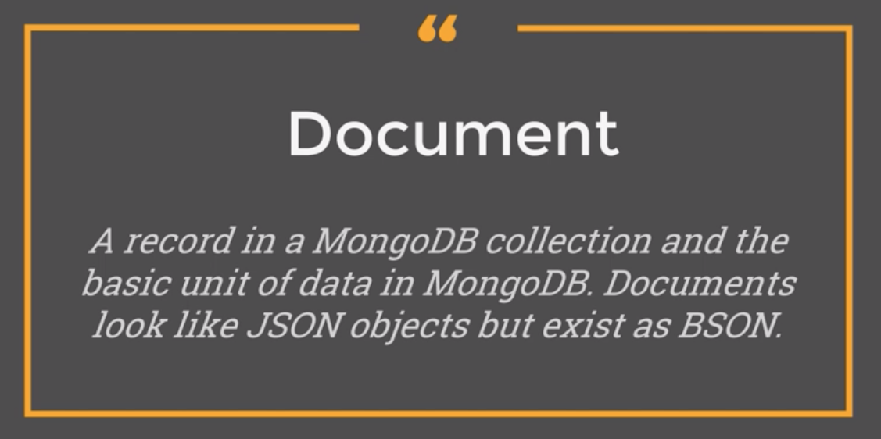

Slide 14
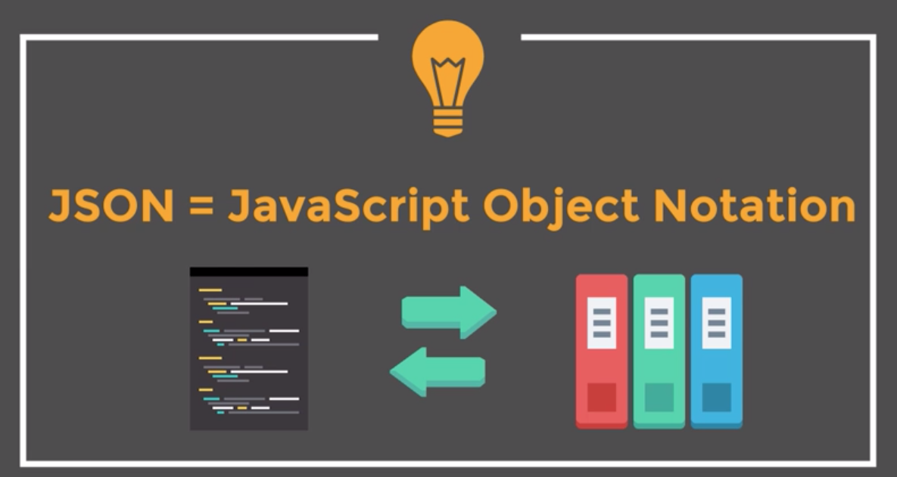

Slide 15
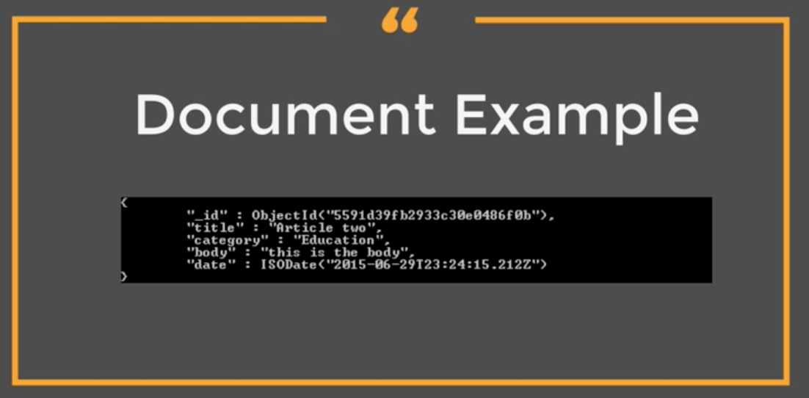

Slide 16
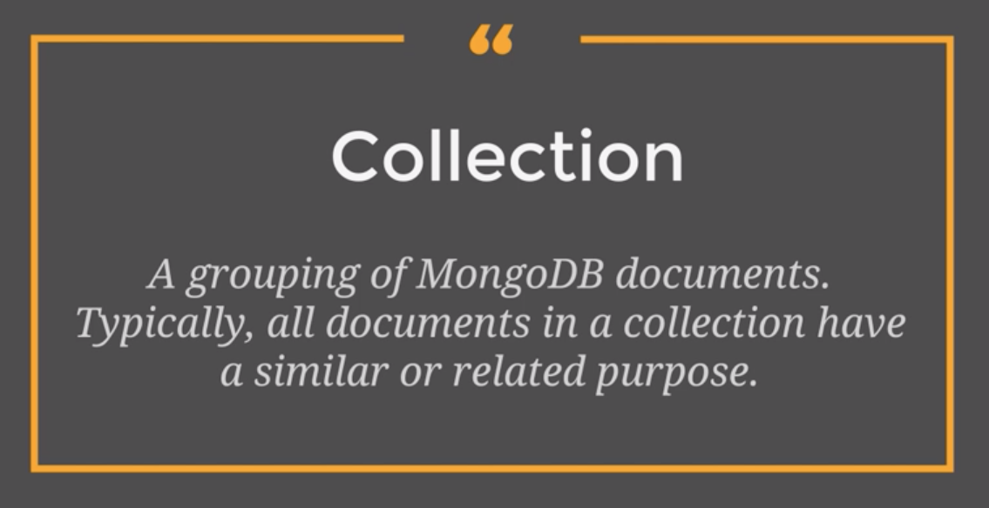

Slide 17
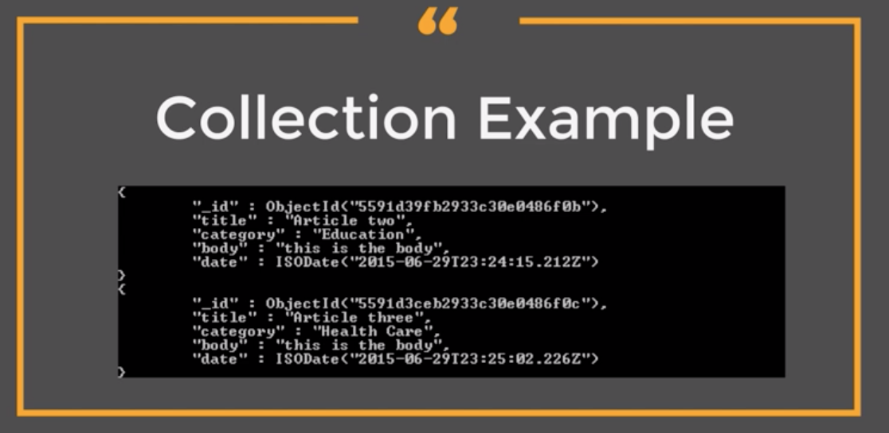

Slide 18
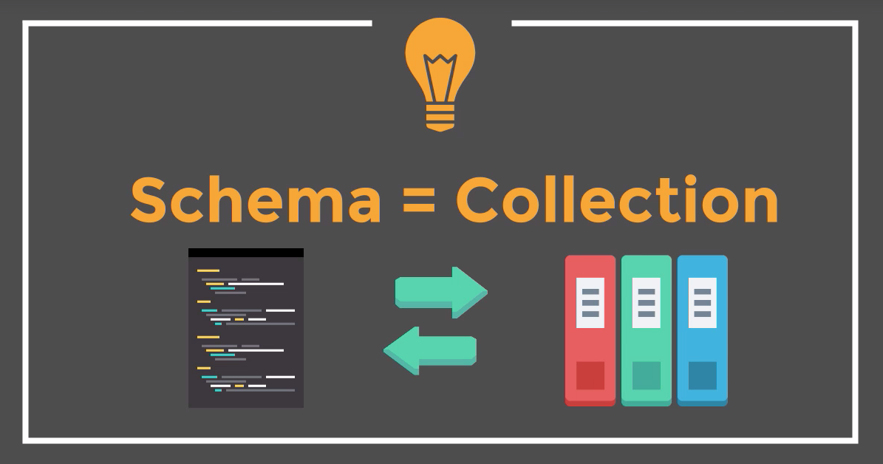

Slide 19


Slide 20
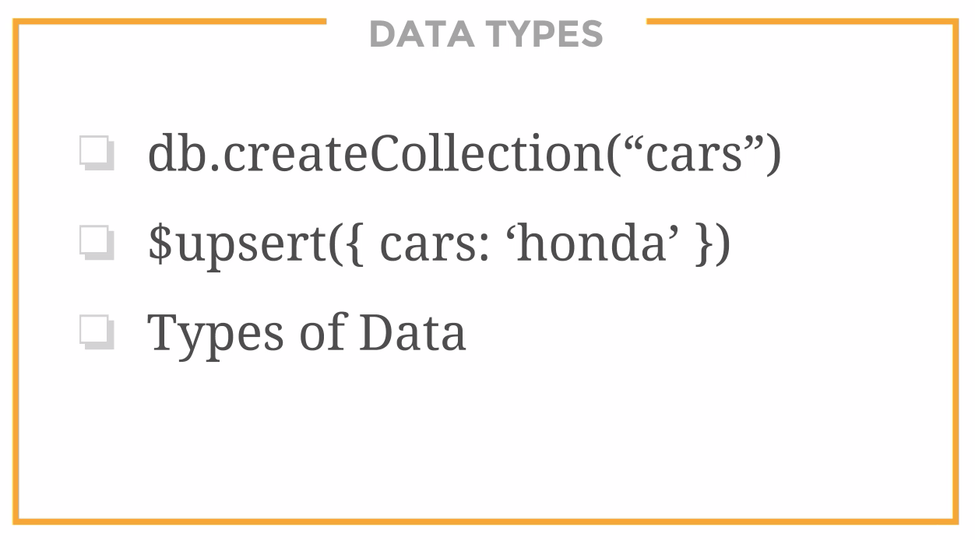

Slide 21
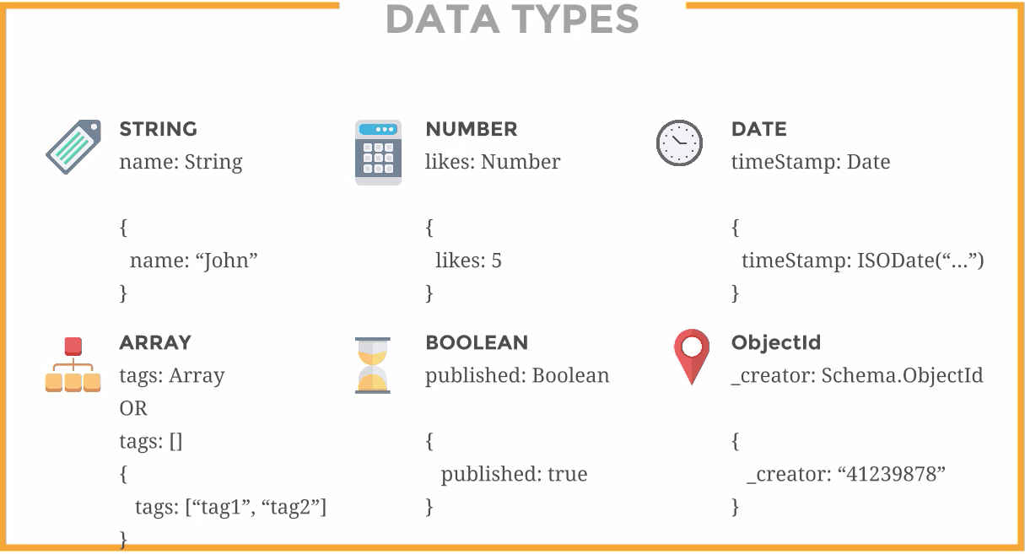

Slide 22
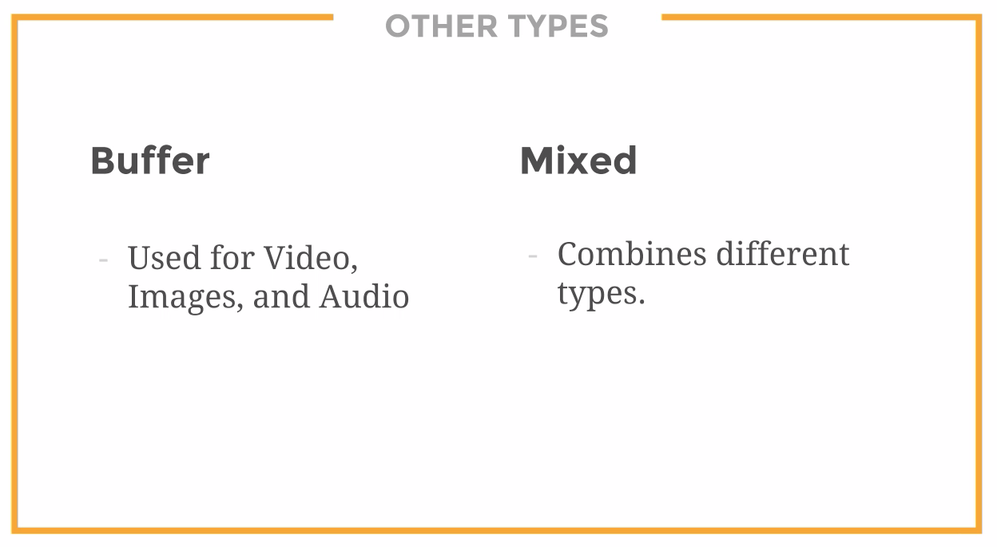

Slide 23
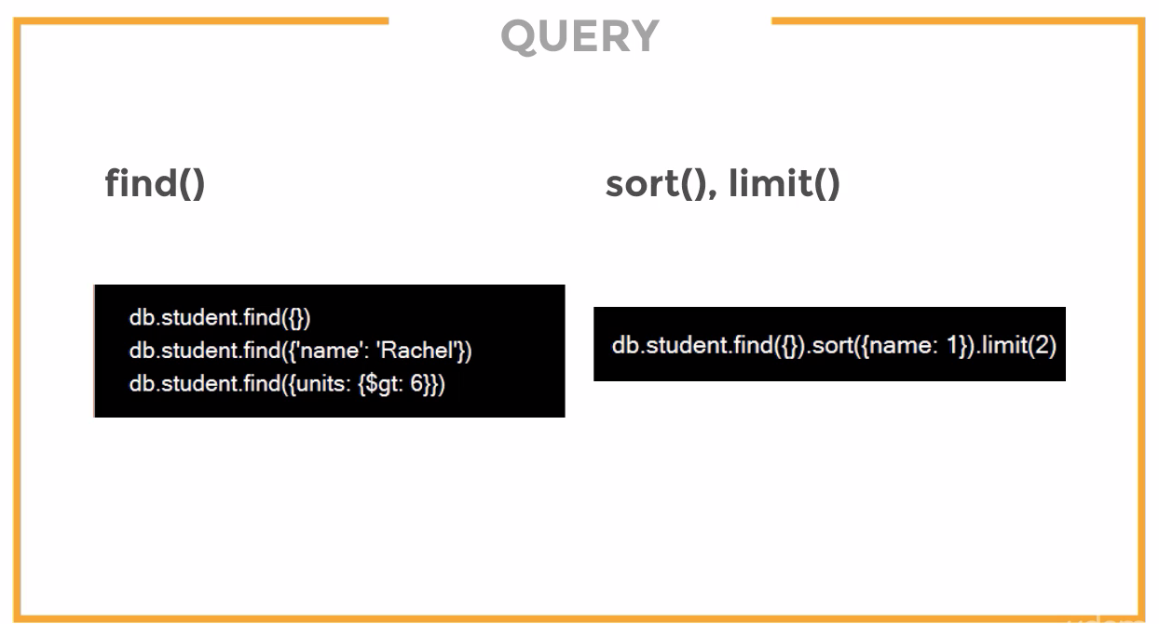

Slide 24
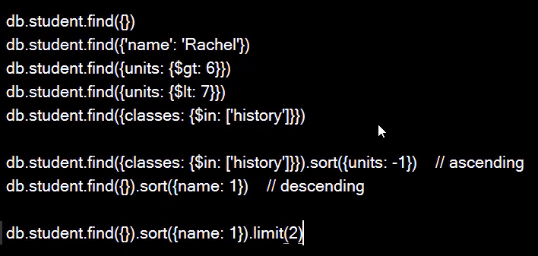

Slide 25
https://docs.mongodb.com/manual/tutorial/query-documents/

Slide 26
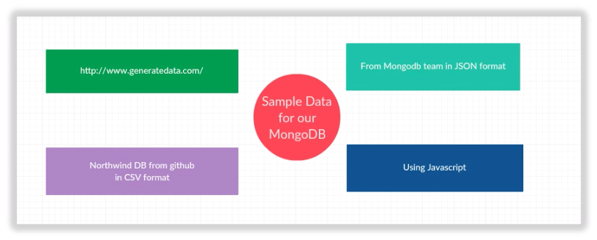
Load Test Data in Mongodb

Slide 27
Mongodb Test Datasets
https://github.com/ozlerhakan/mongodb-json-files
https://raw.githubusercontent.com/mongodb/docs-assets/primer-dataset/primer-dataset.json
http://media.mongodb.org/zips.json
https://github.com/cjlee/northwind
https://github.com/tmcnab/northwind-mongo

Slide 28
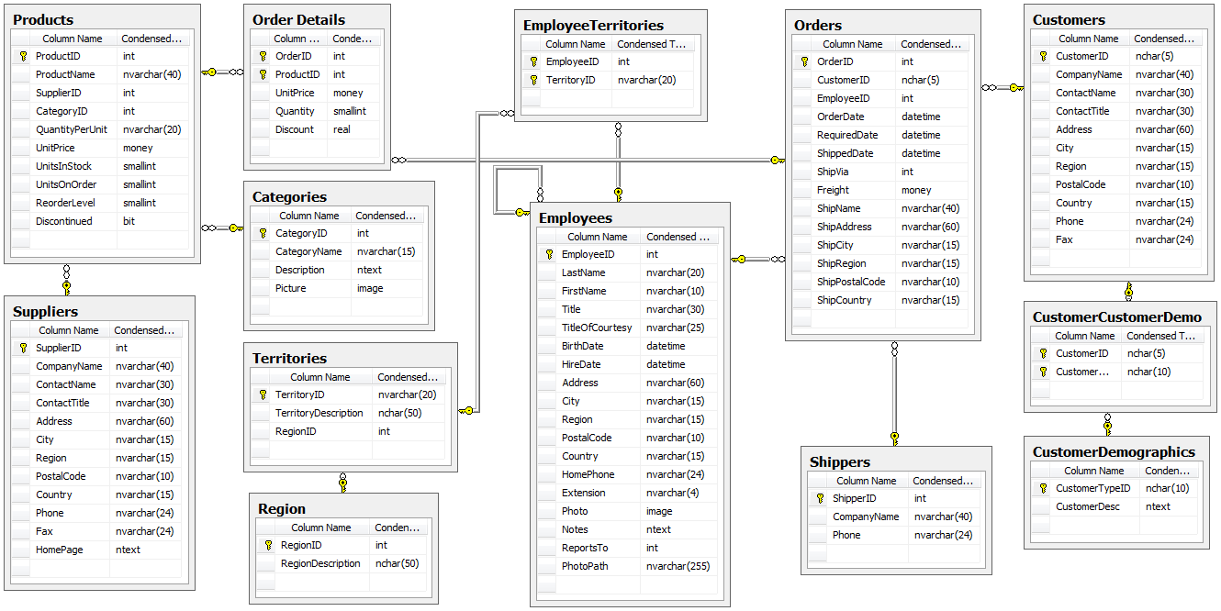
Northwind Database

Slide 29
mongoimport command line tool
https://docs.mongodb.com/manual/reference/program/mongoimport/
Import JSON File
mongoimport --db users --collection contacts --file contacts.json
Import CSV File
mongoimport --db users --collection contacts --type csv --headerline --file /opt/backups/contacts.csv

Slide 30
Generate Dummy Data
https://mockaroo.com/
http://generatedata.com/

Slide 31
Assignment
Use the testdatagenerator available with MongoBooster to generate and Load sample data( for eg) Product details) to MongoDB. Refer here for More info https://mongobooster.com/features#TestDataGenerator
Use https://www.mockaroo.com/ to generate user profile data a JSON output and load the data to MongoDB using MongoBooster and then using Mongoimport utility
Repeat the same Exercise using CSV format output from mockaroo.
Load demo data provided by mongodb team using MongoBooster/MongoImport Tool. Demo Data URL: https://raw.githubusercontent.com/mongodb/docs-assets/primer-dataset/primer-dataset.json
Load again an useful demo dataset provided by mongodb team. The information is available here :https://docs.mongodb.com/manual/tutorial/aggregation-zip-code-data-set/
The collection is available : http://media.mongodb.org/zips.json?_ga=2.261334925.1881078164.1503396731-778080937.1486117063

Slide 32
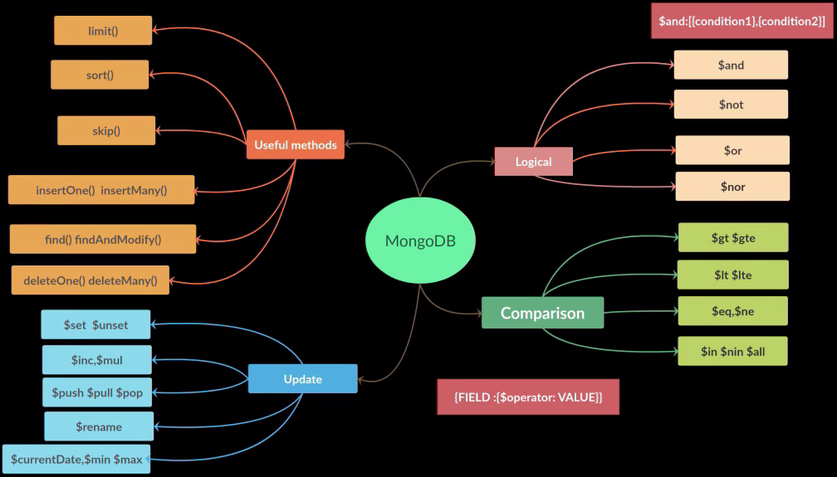
Queries

Slide 33
find(QUERY, FIELDS TO SELECT)
find(QUERY with Conditions, FIELDS TO SELECT)

Slide 34
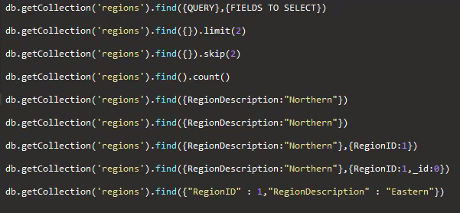

Slide 35
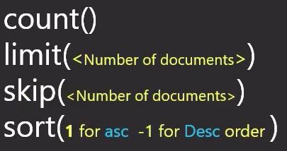

Slide 36
Now Logical and Comparison

Slide 37
Queries Quiz
Question 1:
This Query db.inventory.find( { qty: { $in: [ 5, 15 ] } } ) finds the documents in the collection inventory, having qty as 5 and 15.
Is this correct?

Slide 38
Queries Quiz
Question 1:
This Query db.inventory.find( { qty: { $in: [ 5, 15 ] } } ) finds the documents in the collection inventory, having qty as 5 and 15.
Is this correct?
Ans: No . $in is similar to $or operator. So it selects either 5 or 15
Please visit the MongoDB Documentation page for more info https://docs.mongodb.com/manual/reference/operator/query/in/

Slide 39
Queries Quiz
Question 2:
When performing equality checks on the same field,$in operator is more preferable than $or operator. Is this True?
Is this correct?

Slide 40
Queries Quiz
Question 2:
When performing equality checks on the same field,$in operator is more preferable than $or operator. Is this True?
Is this correct?
Ans: Yes
Please visit the MongoDB Documentation page for more info https://docs.mongodb.com/manual/reference/operator/query/in/

Slide 41
Queries Quiz
Question 3:
In this Query using $not operator, the result will have two types of documents
Documents with the price field value is less than or equal to 1.99
Documents without price field
db.inventory.find( { price: { $not: { $gt: 1.99 } } } )
Is this correct?

Slide 42
Queries Quiz
Question 3:
In this Query using $not operator, the result will have two types of documents
Documents with the price field value is less than or equal to 1.99
Documents without price field
db.inventory.find( { price: { $not: { $gt: 1.99 } } } )
Is this correct?
Ans: Yes
Please visit the MongoDB Documentation page for more info https://docs.mongodb.com/manual/reference/operator/query/not/

Slide 43
Queries Quiz
Question 4:
In this Query using $lte operator, the result will have two types of documents
Documents with the qty field value is less than or equal to 20
Documents without qty field
db.inventory.find( { qty: { $lte: 20 } } )
Is this correct?

Slide 44
Queries Quiz
Question 4:
In this Query using $lte operator, the result will have two types of documents
Documents with the qty field value is less than or equal to 20
Documents without qty field
db.inventory.find( { qty: { $lte: 20 } } )
Is this correct?
Ans: No. It wont return documents without qty field, contrary to the $not operator.
Please visit the MongoDB Documentation page for more info https://docs.mongodb.com/manual/reference/operator/query/lte/

Slide 45
Queries Quiz
Question 5:
This Query will produce the _id field in the result. Is this True?
db.products.find( { qty: { $gt: 25 } }, { item: 1, qty: 1 } )
Is this correct?

Slide 46
Queries Quiz
Question 5:
This Query will produce the _id field in the result. Is this True?
db.products.find( { qty: { $gt: 25 } }, { item: 1, qty: 1 } )
Is this correct?
Ans: Yes, _id is not specifically filtered out in the above Query.
Please visit the MongoDB Documentation page for more info https://docs.mongodb.com/manual/reference/method/db.collection.find/

Slide 47
Queries Quiz
Question 6:
In the Query result of the below query all the fields will appear in the result except the _id and the Qty Field.
db.products.find( { qty: { $gt: 25 } }, { _id: 0, qty: 0 } )
Is this correct?

Slide 48
Queries Quiz
Question 6:
In the Query result of the below query all the fields will appear in the result except the _id and the Qty Field.
db.products.find( { qty: { $gt: 25 } }, { _id: 0, qty: 0 } )
Is this correct?
Ans: Yes, Because _id and Qty are explicitly filtered out.
Please visit the MongoDB Documentation page for more info https://docs.mongodb.com/manual/reference/method/db.collection.find/

Slide 49
Queries Quiz
Question 7:
The two statements produce equal results.
db.bios.find().sort( { name: 1 } ).limit( 5 )
db.bios.find().limit( 5 ).sort( { name: 1 } )
Is this correct?

Slide 50
Queries Quiz
Question 7:
The two statements produce equal results.
db.bios.find().sort( { name: 1 } ).limit( 5 )
db.bios.find().limit( 5 ).sort( { name: 1 } )
Is this correct?
Ans: Yes, The order of limit() and the sort() methods is not significant.
Please visit the MongoDB Documentation page for more info https://docs.mongodb.com/manual/reference/method/db.collection.find/

Slide 51
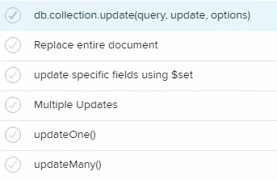
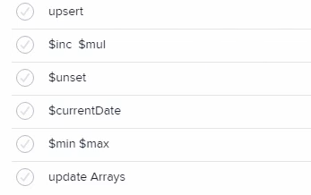
Update Documents

Slide 52
Delete Documents
deleteOne()
deleteMany()
remove() with option (justOne)

Slide 53
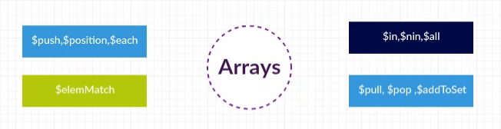
Working with Arrays

Slide 54
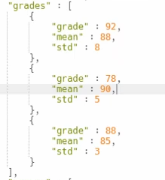
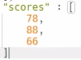
Types of Array Data
complex / associative
simple

Slide 55
Working with Arrays

Slide 56
Array Quiz
Question 1:
Using $length array Operator, we can find documents with arrays with the number of elements specified.
Is this correct?

Slide 57
Array Quiz
Question 1:
Using $length array Operator, we can find documents with arrays with the number of elements specified.
Is this correct?
Ans: Nope. Its $size array Operator.
Please visit the MongoDB Documentation page for more info https://docs.mongodb.com/manual/reference/operator/query/size/#op._S_size

Slide 58
Array Quiz
Question 2:
$all Array Operator is similar to $or operation .Selects all documents where the array has even a single element matching the values passed in the $all operator.
Is this correct?

Slide 59
Array Quiz
Question 2:
$all Array Operator is similar to $or operation .Selects all documents where the array has even a single element matching the values passed in the $all operator.
Is this correct?
Ans: No, Its the opposite way. Its like $and operation. Selects complete matching.
Please visit the MongoDB Documentation page for more info https://docs.mongodb.com/manual/reference/operator/query/all/

Slide 60
Array Quiz
Question 3:
$elemMatch operator supports multiple queries,so documents with array fields, with atleast one element matching the specified Queries will be returned.
Is this correct?

Slide 61
Array Quiz
Question 3:
$elemMatch operator supports multiple queries,so documents with array fields, with atleast one element matching the specified Queries will be returned.
Is this correct?
Ans: yes, You can get more info about $elemMatch
Please visit the MongoDB Documentation page for more info https://docs.mongodb.com/manual/reference/operator/query/elemMatch/#op._S_elemMatch

Slide 62
Array Quiz
Question 4:
We cannot pass multiple Query conditions[Compound Filter Conditions on the Array Elements] to find method. For that we have to use $elemMatch operator .
Is this correct?

Slide 63
Array Quiz
Question 4:
We cannot pass multiple Query conditions[Compound Filter Conditions on the Array Elements] to find method. For that we have to use $elemMatch operator .
Is this correct?
Ans:Nope. You can pass multiple Query criteria to find method.
Please visit the MongoDB Documentation page for more info https://docs.mongodb.com/manual/tutorial/query-arrays/

Slide 64
Schema Design

Slide 65
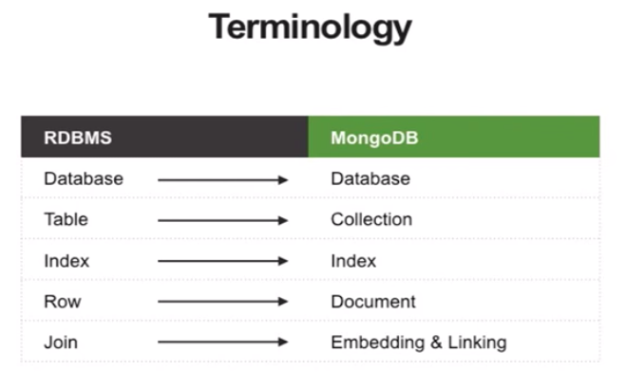

Slide 66
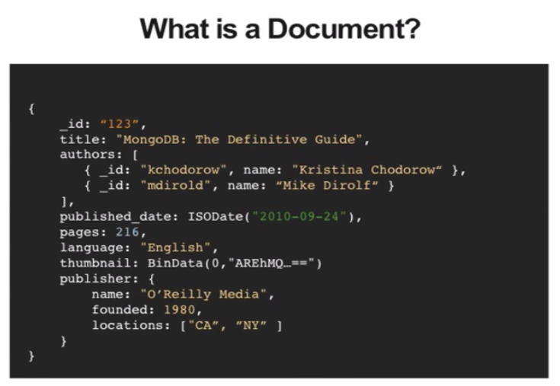

Slide 67
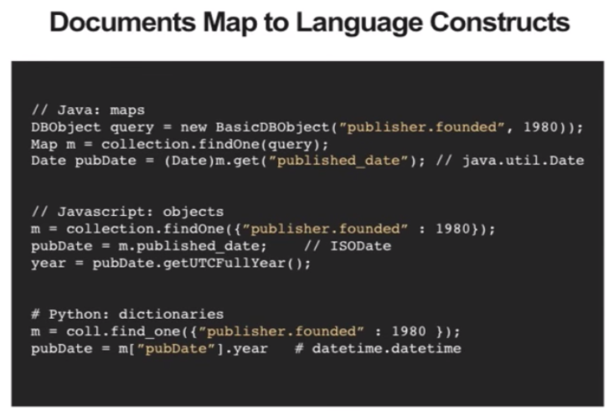

Slide 68
Full Text Search

Slide 69
Replica Set

Slide 70
Sharding

Slide 71
GridFS

Slide 72
Map Reduce

Slide 73
REGEX

Slide 74
Indexing

Slide 75
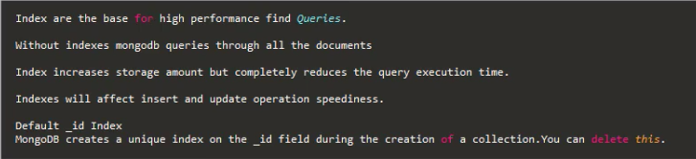
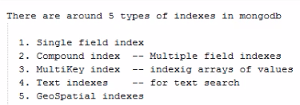
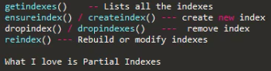
Indexing

Slide 76
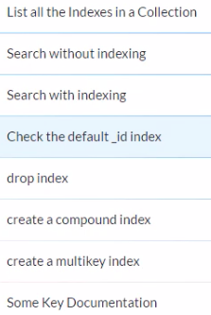

Slide 77
Mongodump & Restore

Slide 78
Tools
Robomongo / Robo3T
MongodbBooster / NoSQLBooster
MongoChef / Studio 3T (Not Free)
NoSql Manager / Mongodbmanager

